Slide 1
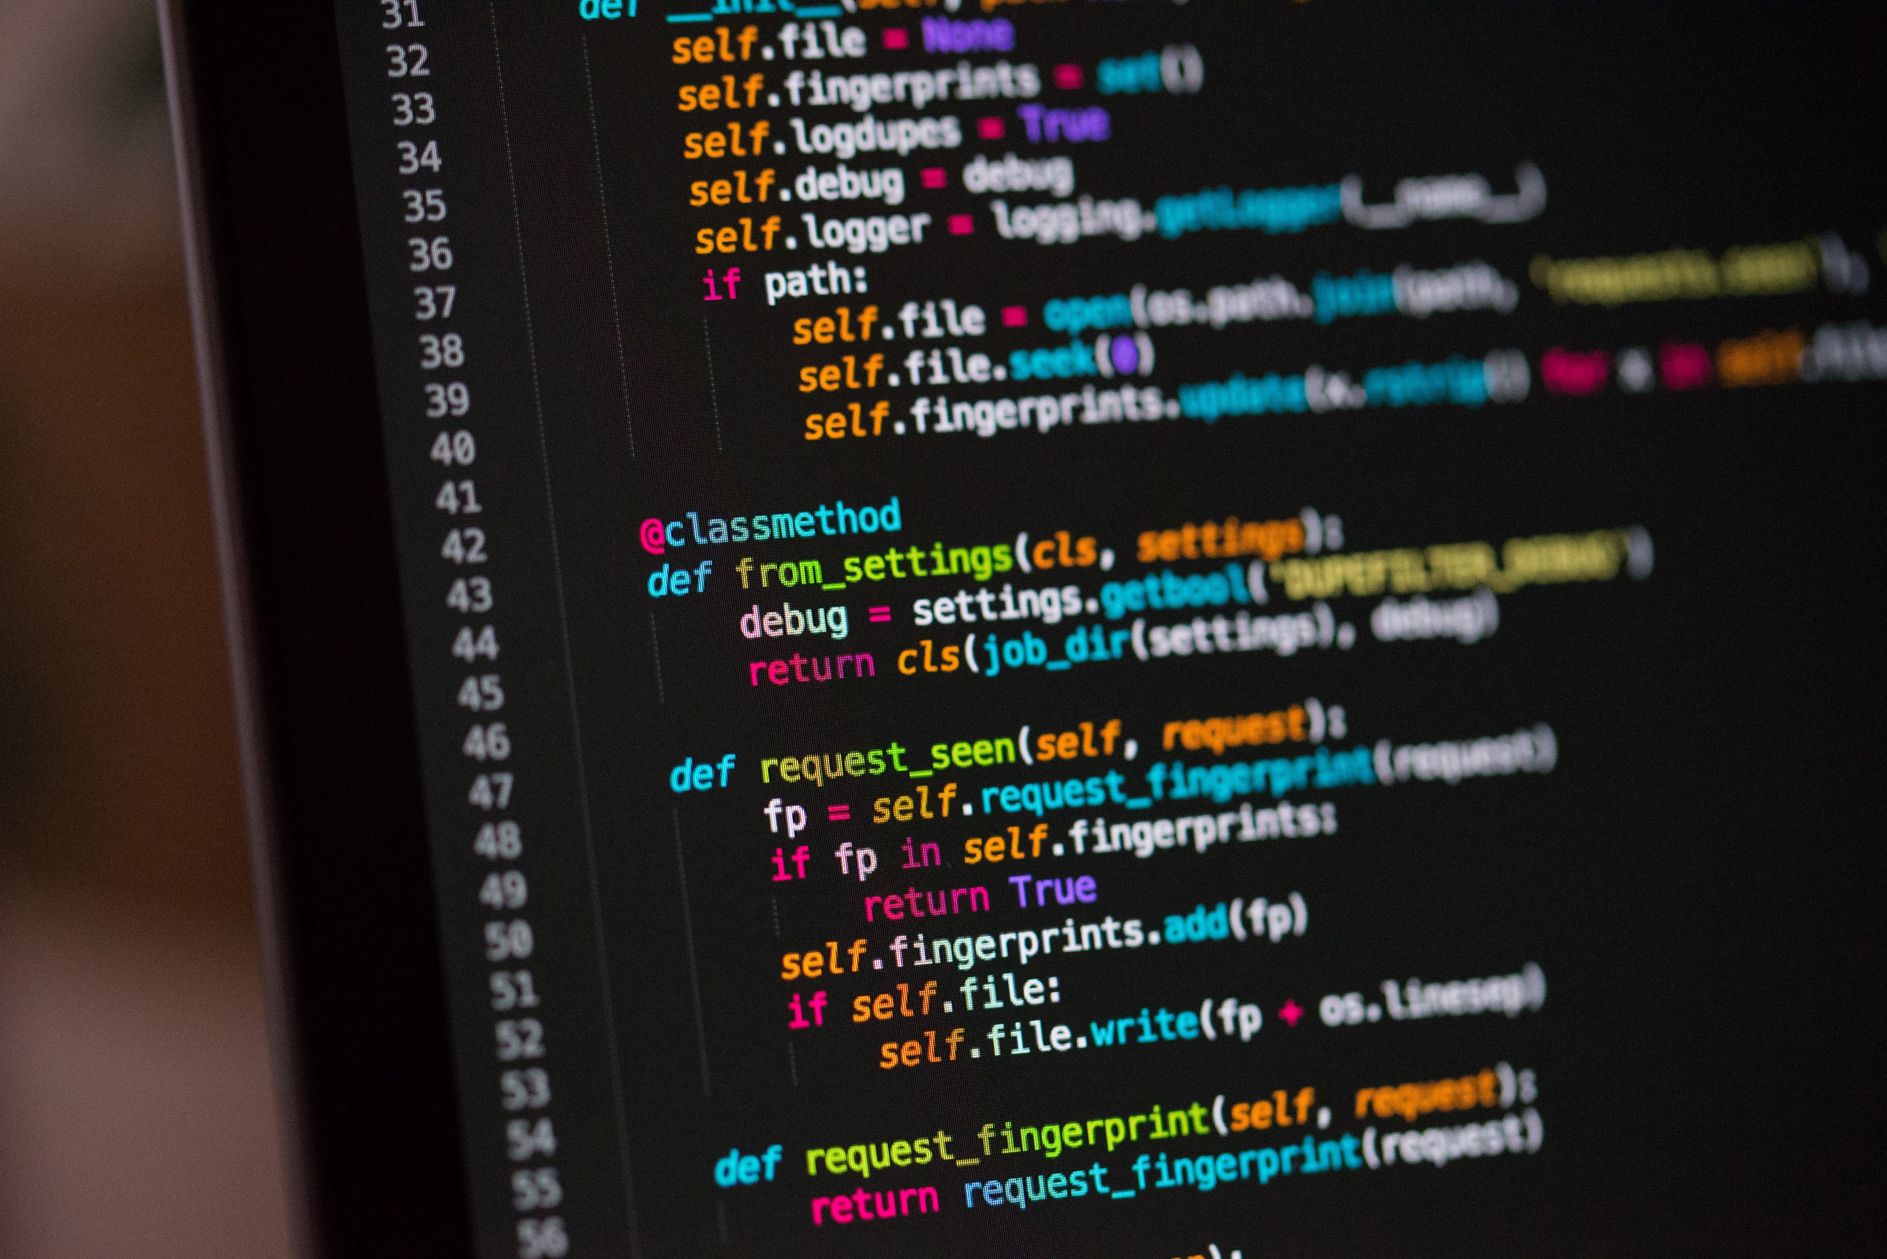


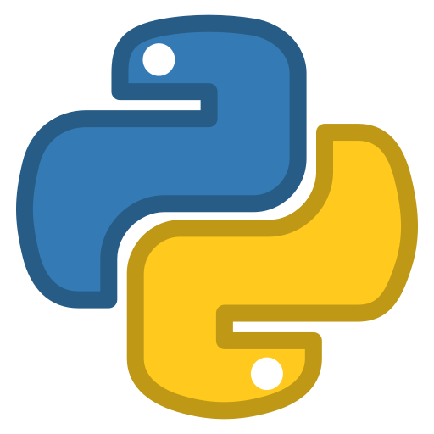

How To Use Google Colab
Generated by AI with Canva
Python Refresher for Sustainable Energy Management Module

Slide 2
How To Use Google Colab
What is Google Colab?
Google Colab, short for Colaboratory, is a free, cloud-based platform provided by Google that allows you to write and execute Python code in a web-based interactive environment
What is Google Colab?
Generated by AI with Canva
Python Refresher for Sustainable Energy Management Module

Slide 3
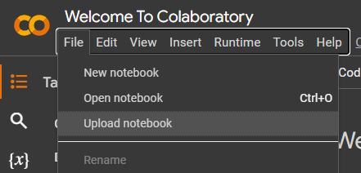
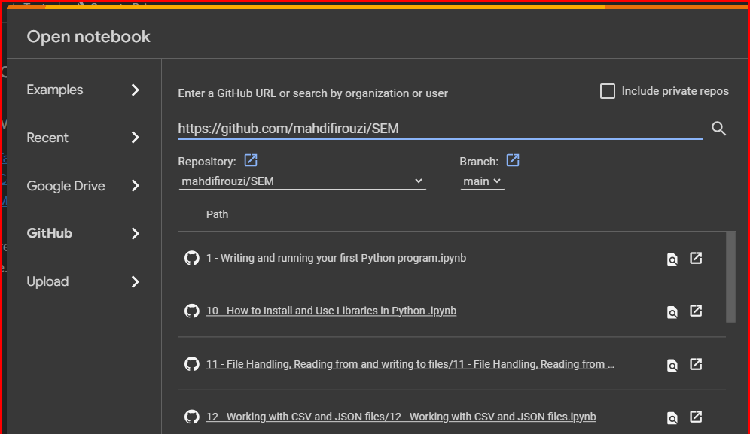

How to use Google Colab
How to Open Notebooks
Go to Google Colab Website: https://colab.research.google.com/
Click on Upload notebook and GitHub and then paste GitHub Repository address
(https://github.com/mahdifirouzi/SEM) On the search bar and click on search
Then you can Open the notebooks inside GitHub Repository:
Python Refresher for Sustainable Energy Management Module
3

Slide 4
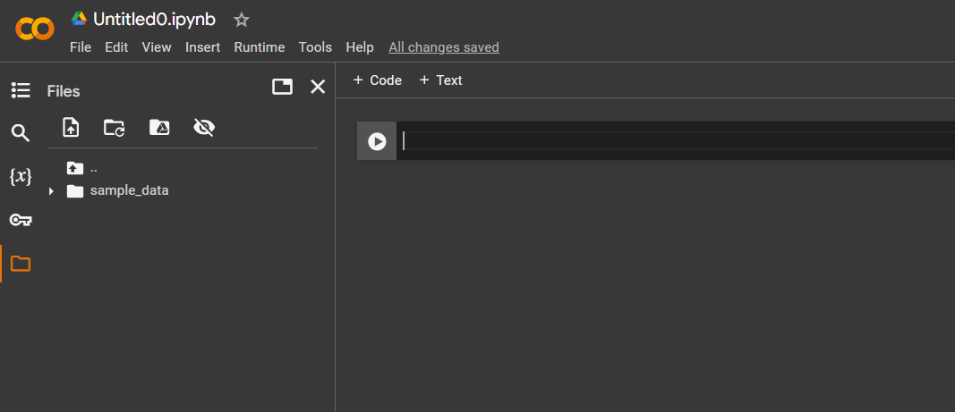
How to use Google Colab
How to use Files on Google Colab
Open files to see the files by clicking on folder icon:
Python Refresher for Sustainable Energy Management Module
4

Slide 5
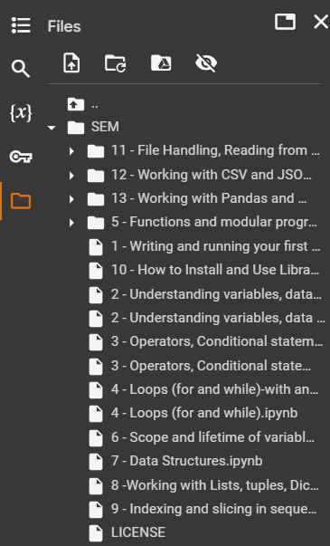
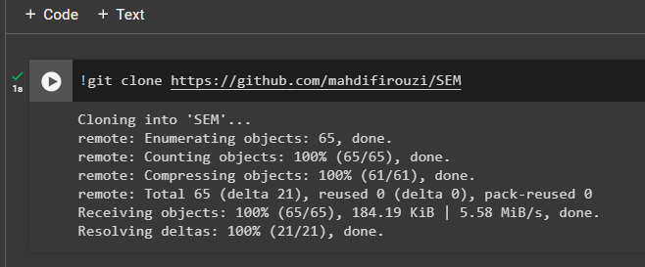
How to use Google Colab
How to use Files on Google Colab
Type this code to get ipython files from GitHub: !git clone https://github.com/mahdifirouzi/SEM
And run it to get the files from GitHub
After Completion of Cloning you can see your files inside file explorer
This files can not be opened just you can make use of them inside your program
Python Refresher for Sustainable Energy Management Module
5

Slide 6
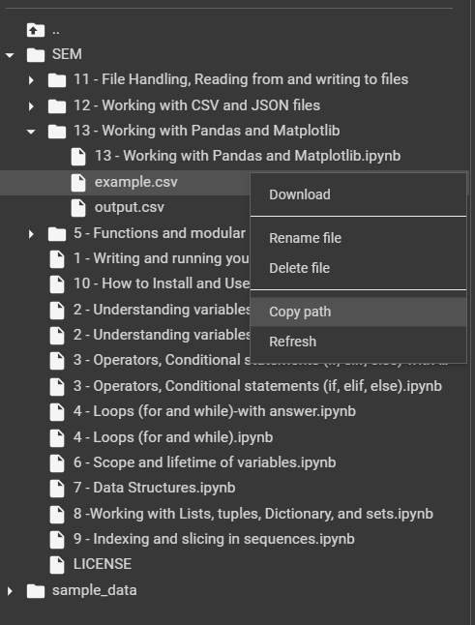
How to use Google Colab
How to use Files on Google Colab
You can Use Copy path for using that files inside your program
For this example the path is:
/content/SEM/13 - Working with Pandas and Matplotlib/example.csv
Python Refresher for Sustainable Energy Management Module
6

Slide 7
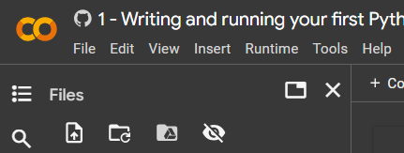
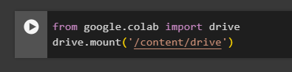
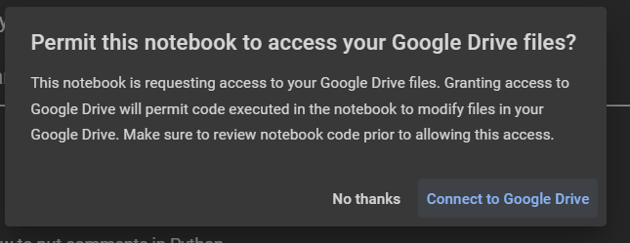
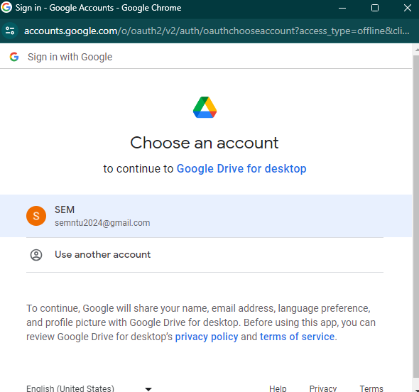
How to use Google Colab
How to use Mount Google Drive Files on Google Colab
Click on google drive icon:
This Cell wil be appeared on your notebook and
Run it:
Click on this window:
Then give the access to your google colab files:
Python Refresher for Sustainable Energy Management Module
7

Slide 8
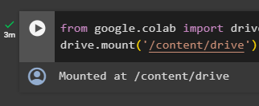
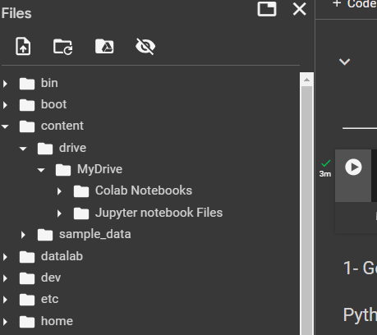
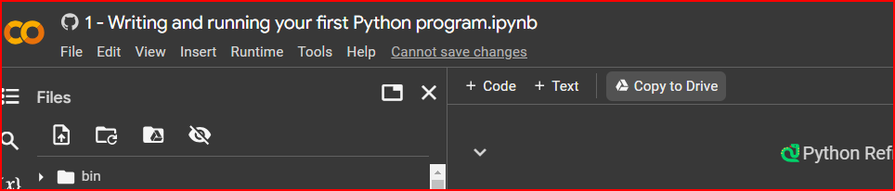
How to use Google Colab
How to use Mount Google Drive Files on Google Colab
If the mount is succesfull you can see Mounted at like this:
This Files appear inside the directory /content/drive/
You can see your saved Colab Notebooks inside the Colab Notebooks folder
By clicking on copy to drive button you can ensure you have the files saved inside
Your google Drive
Python Refresher for Sustainable Energy Management Module
8

Slide 9
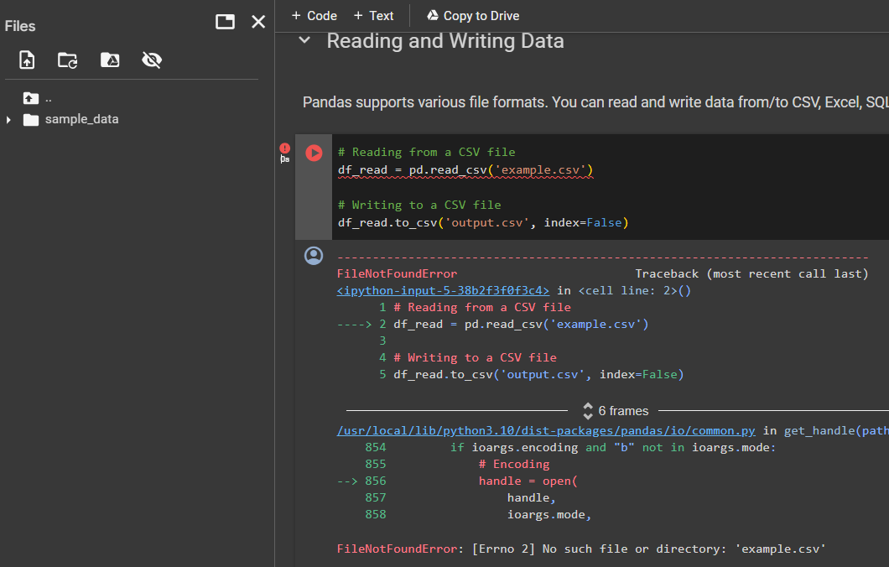
How to use Google Colab
How to change files directory to Google Colab
When using google colab the files directory is different from what you have inside your personal computer so you have to change file directories to proper one here is an example:
When I run this code I got an Error because
the example.csv file is not In my current directory,
you have to upload the file there or give the proper
Directory from the files you cloned before from Github
current directory
Python Refresher for Sustainable Energy Management Module
9

Slide 10
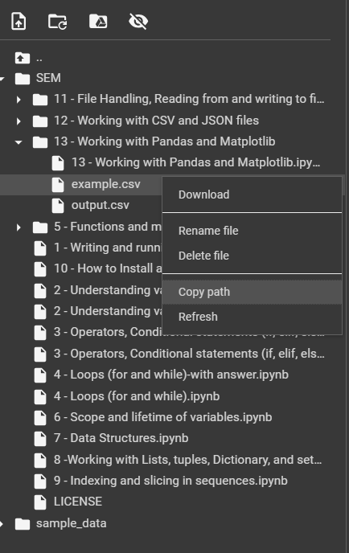
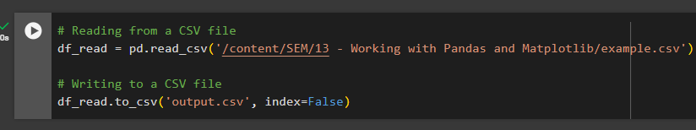
How to use Google Colab
How to change files directory to Google Colab
Now I find the file from cloned files from GitHub and copy the path:
/content/SEM/13 - Working with Pandas and Matplotlib/example.csv
Then change the path of the file inside the code:
current directory
So your code now can be executed successfully
Python Refresher for Sustainable Energy Management Module
10

Slide 11
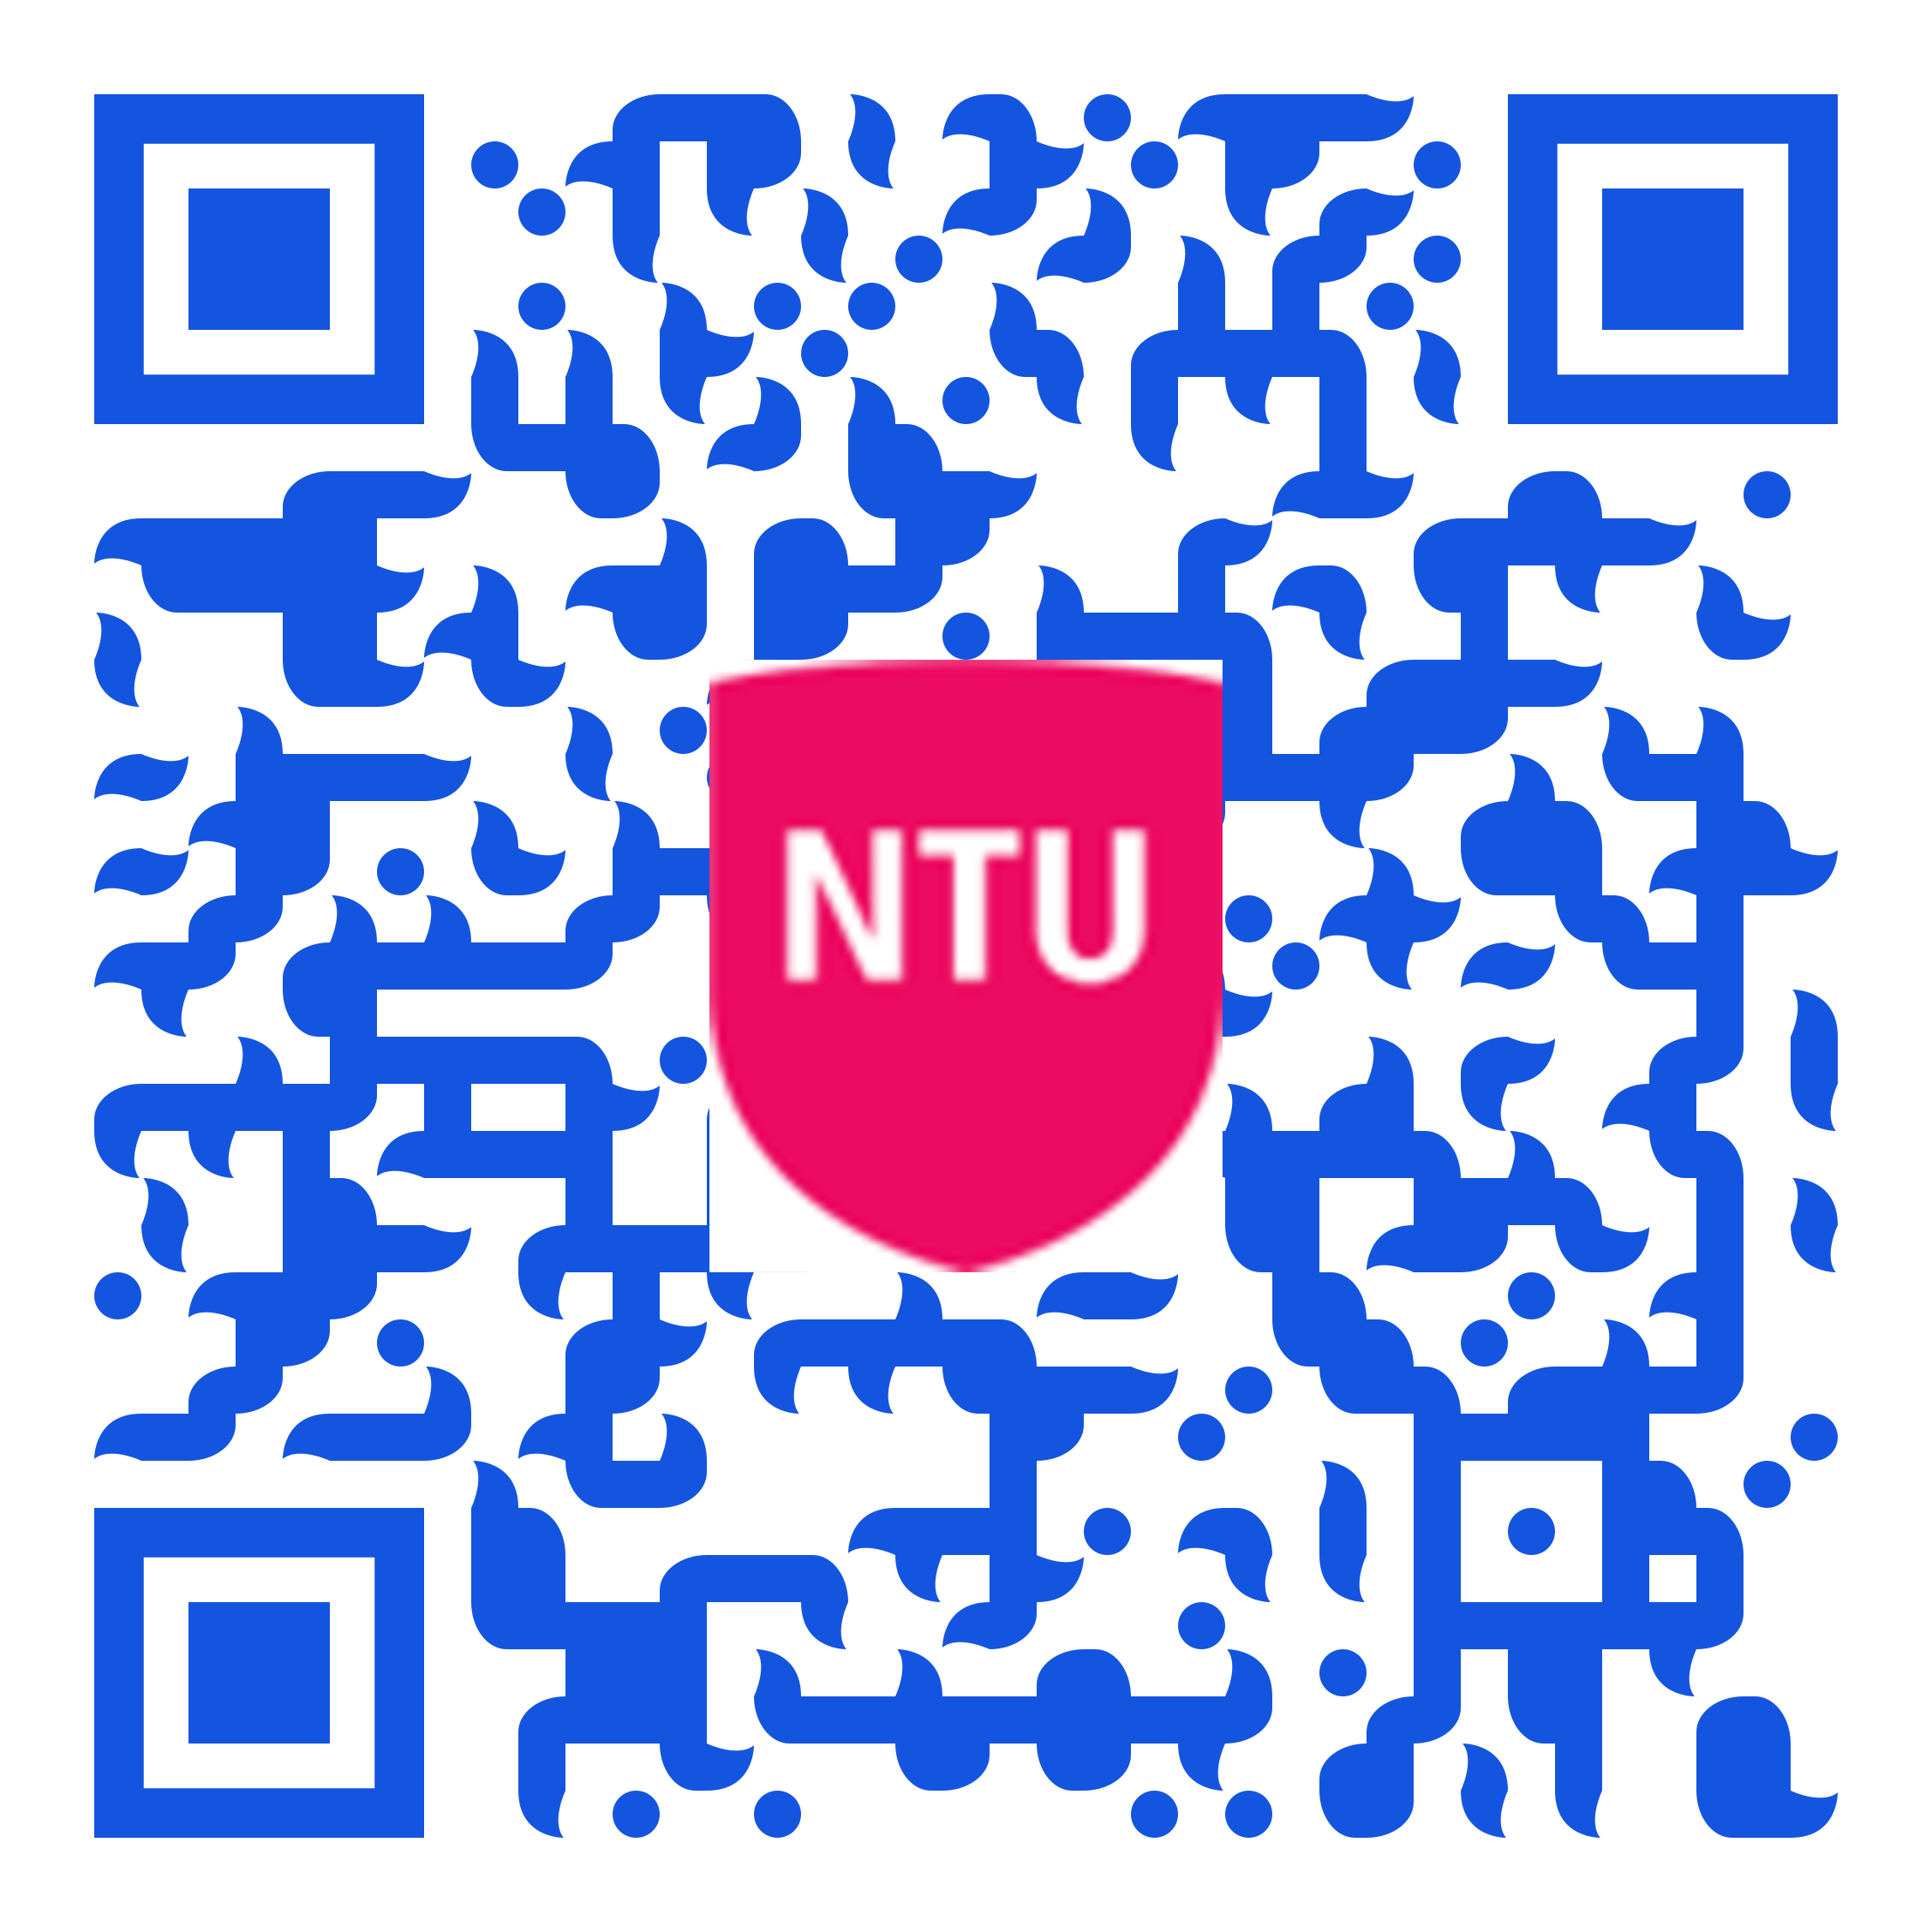
Link to access Jupyter notebook files and Slides on Github:
11

